Slide 1
Variables and Levels of Measurements
By: Eli Dalton

Slide 2
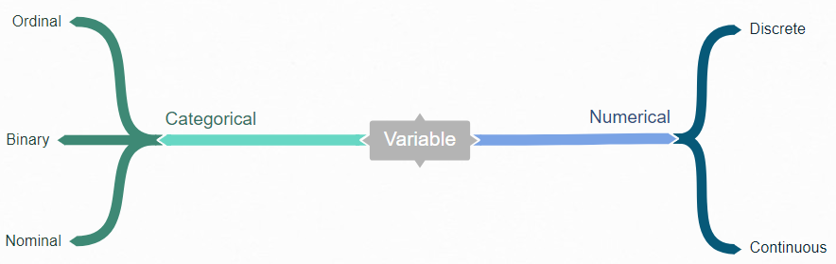
What is a Variable?
“A variable is any characteristic, number, or quantity that can be measured or counted”

Slide 3
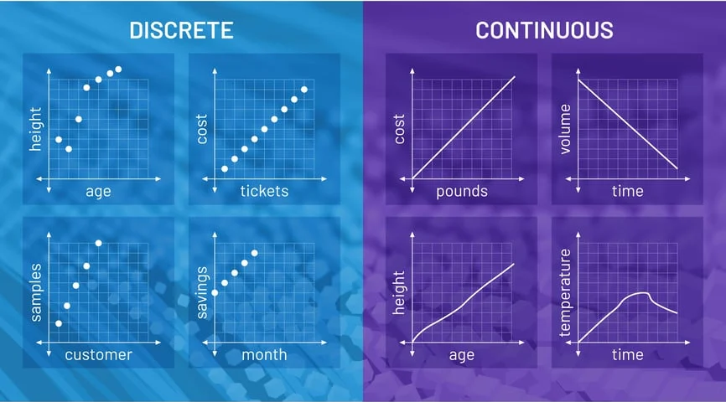
Numerical Variables:
Measurable data, represented as numbers not words or text
Fall into two more specific categories:
Discrete: countable in a finite amount of time
Continuous: would take forever to count

Slide 4
Categorical Variables:
Any data that is not a number (string of text or a date)
Fall into three more specific categories:
Nominal: discrete values with no numerical relationship
Ordinal: discrete integers that can be ranked or sorted
Binary: data types that only have two values
City
Marital Status
Language
Satisfaction
Ranking: 1st, 2nd, 3rd
Taxonomic Ranking
Yes or No
True or False
0 or 1

Slide 5
Additional Variable Specifications:
Interval Data: equal spacing with no true zero
Can represent values below zero
Ratio Data: units of equal magnitude and rank order on a scale with an absolute zero
Independent Variable: is the cause/not effected by others
Dependent Variable: is the effect/relies on changes in the independent variable(s)
Temperature in Fahrenheit Scale
Height and Weight
Amount of Rain and Plant Growth

Slide 6
Levels of Measurement:
There are 4 levels of measurement
These levels of measurement together with your research question determine what statistical analysis is appropriate
Interval
Nominal
Ratio
Ordinal

Slide 7
Sources:
https://www.abs.gov.au/statistics/understanding-statistics/statistical-terms-and-concepts/variables#:~:text=Close-,Definition,type%20are%20examples%20of%20variables.
https://www.statisticssolutions.com/dissertation-resources/descriptive-statistics/data-levels-of-measurement/#:~:text=A%20variable%20has%20one%20of,sometimes%20called%20Continuous%20or%20Scale).
Presentation PowerPoint #3

